Slide 1
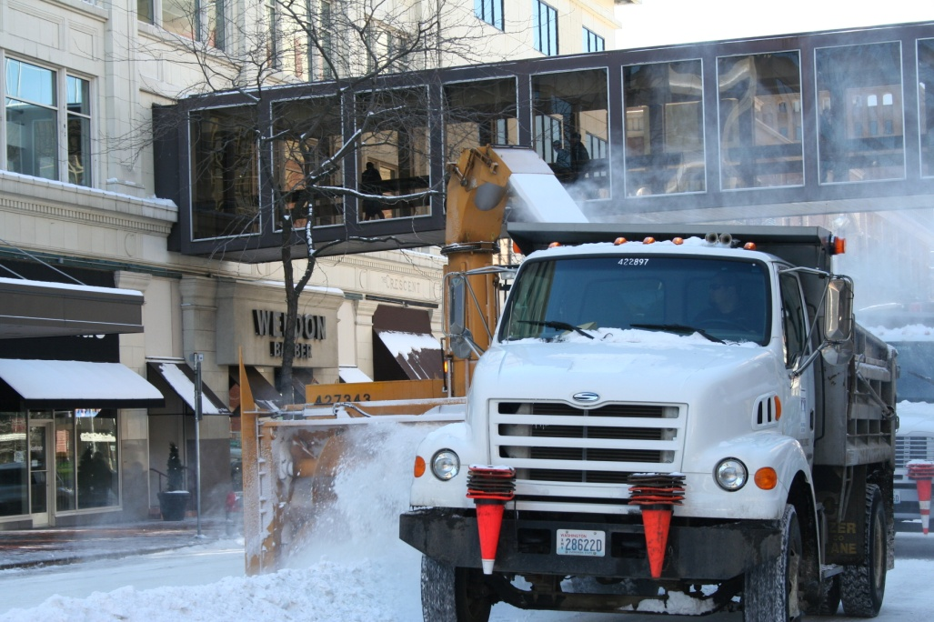
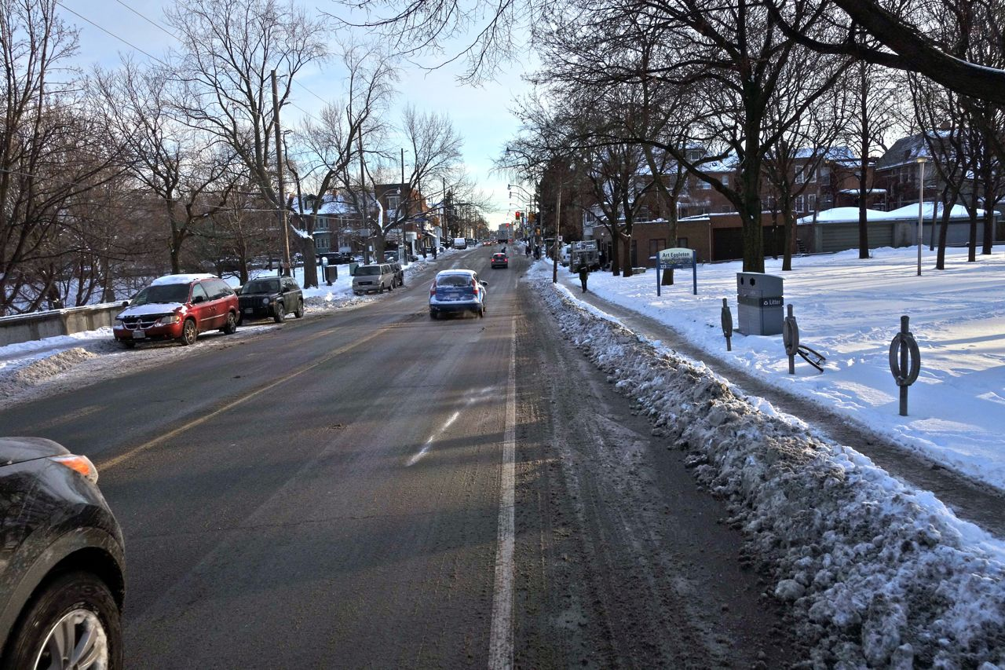
When it snows, we respond.
Snow season November 15-March 15

Slide 2
Our Plan was improved by YOU!
Based on your feedback, our current snow response plan features:
More plowing, sooner.
More equipment and people available for snow removal.
Completion of a full-City plow during heavier snowfalls more quickly – in about 3 days.
Use of equipment that minimizes driveway berms.
Greater emphasis on plowing snow away from sidewalks.
Focus on routes to schools, medical facilities & more

Slide 3
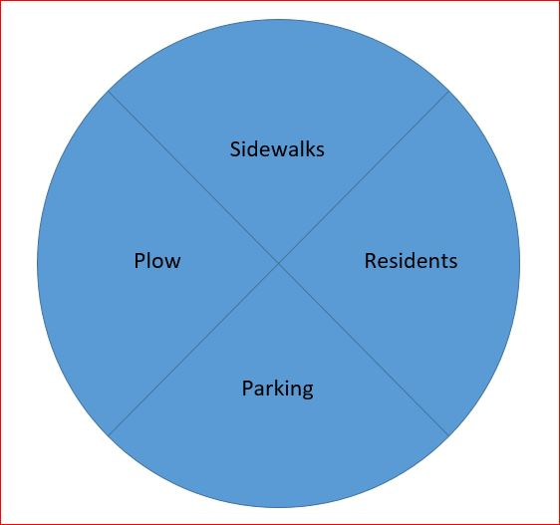
Interrelated Components & A Holistic Approach
Each of these components plays a vital role in our snow season
There’s a domino effect when any part of the plan is missing

Slide 4
Overview
Snow Season – November 15 to March 15
  Moving away from event-based and reactive approach to proactive plan for the season
  Be prepared
Coordinated System
  Street Plowing
  Sidewalk Snow Removal
  Parking
Accountability and Collaboration
  Plowing will minimize impact to parking and sidewalks
  City will maintain its sidewalks
  Help others connect with resources and plan ahead
  Help out by doing your part for parking and sidewalk snow removal
Continuous Improvement
  Continuing with last year’s changes, adding more gates, further improving communication

Slide 5
Plowing
When it snows, even if it’s an inch or two, crews will plow all the streets, including residential streets.
  As part of the regular work day, Monday through Friday, crews will clear snow throughout the City when there are small amounts of snow
  Utility crews will supplement Street crews sooner
  More equipment will be available on a regular basis for plowing
  We call this “maintenance plow” work
When a full-City plow is needed, the City will move to 24/7 operations
  A full City plow should take about 3 days under the changed plan.

Slide 6
Driveway Berms
New Equipment
  More than doubled the number of snow gates for the 2018-19 Snow Season
  16 gates this year, up from 7
  Won’t completely eliminate berms, especially on arterials, but will drastically reduce them
Plowing Technique Changes
  Plowing away from the curb to help keep snow out of driveways and off sidewalks.
  Snow also may be pushed to center medians on some arterials

Slide 7
Parking
• Seasonal Parking (Nov. 15-March 15)
  Parking on the odd side of the street, all season long with no ticketing or towing
    RVs & Boats: Seasonal Restriction of parking on the street, tow away
      Enforcement is pro-active & complaint based with an emphasized campaign before snow season & warnings
      By Nov. 15, this enforcement will switch to towing
    All areas outside the downtown will be treated the same
  Downtown: No on-street parking, 12-6 a.m. when snow present, tow away area
    Options for off-street parking (next slide)
• Messaging encouraging cooperation & providing options for parking

Slide 8
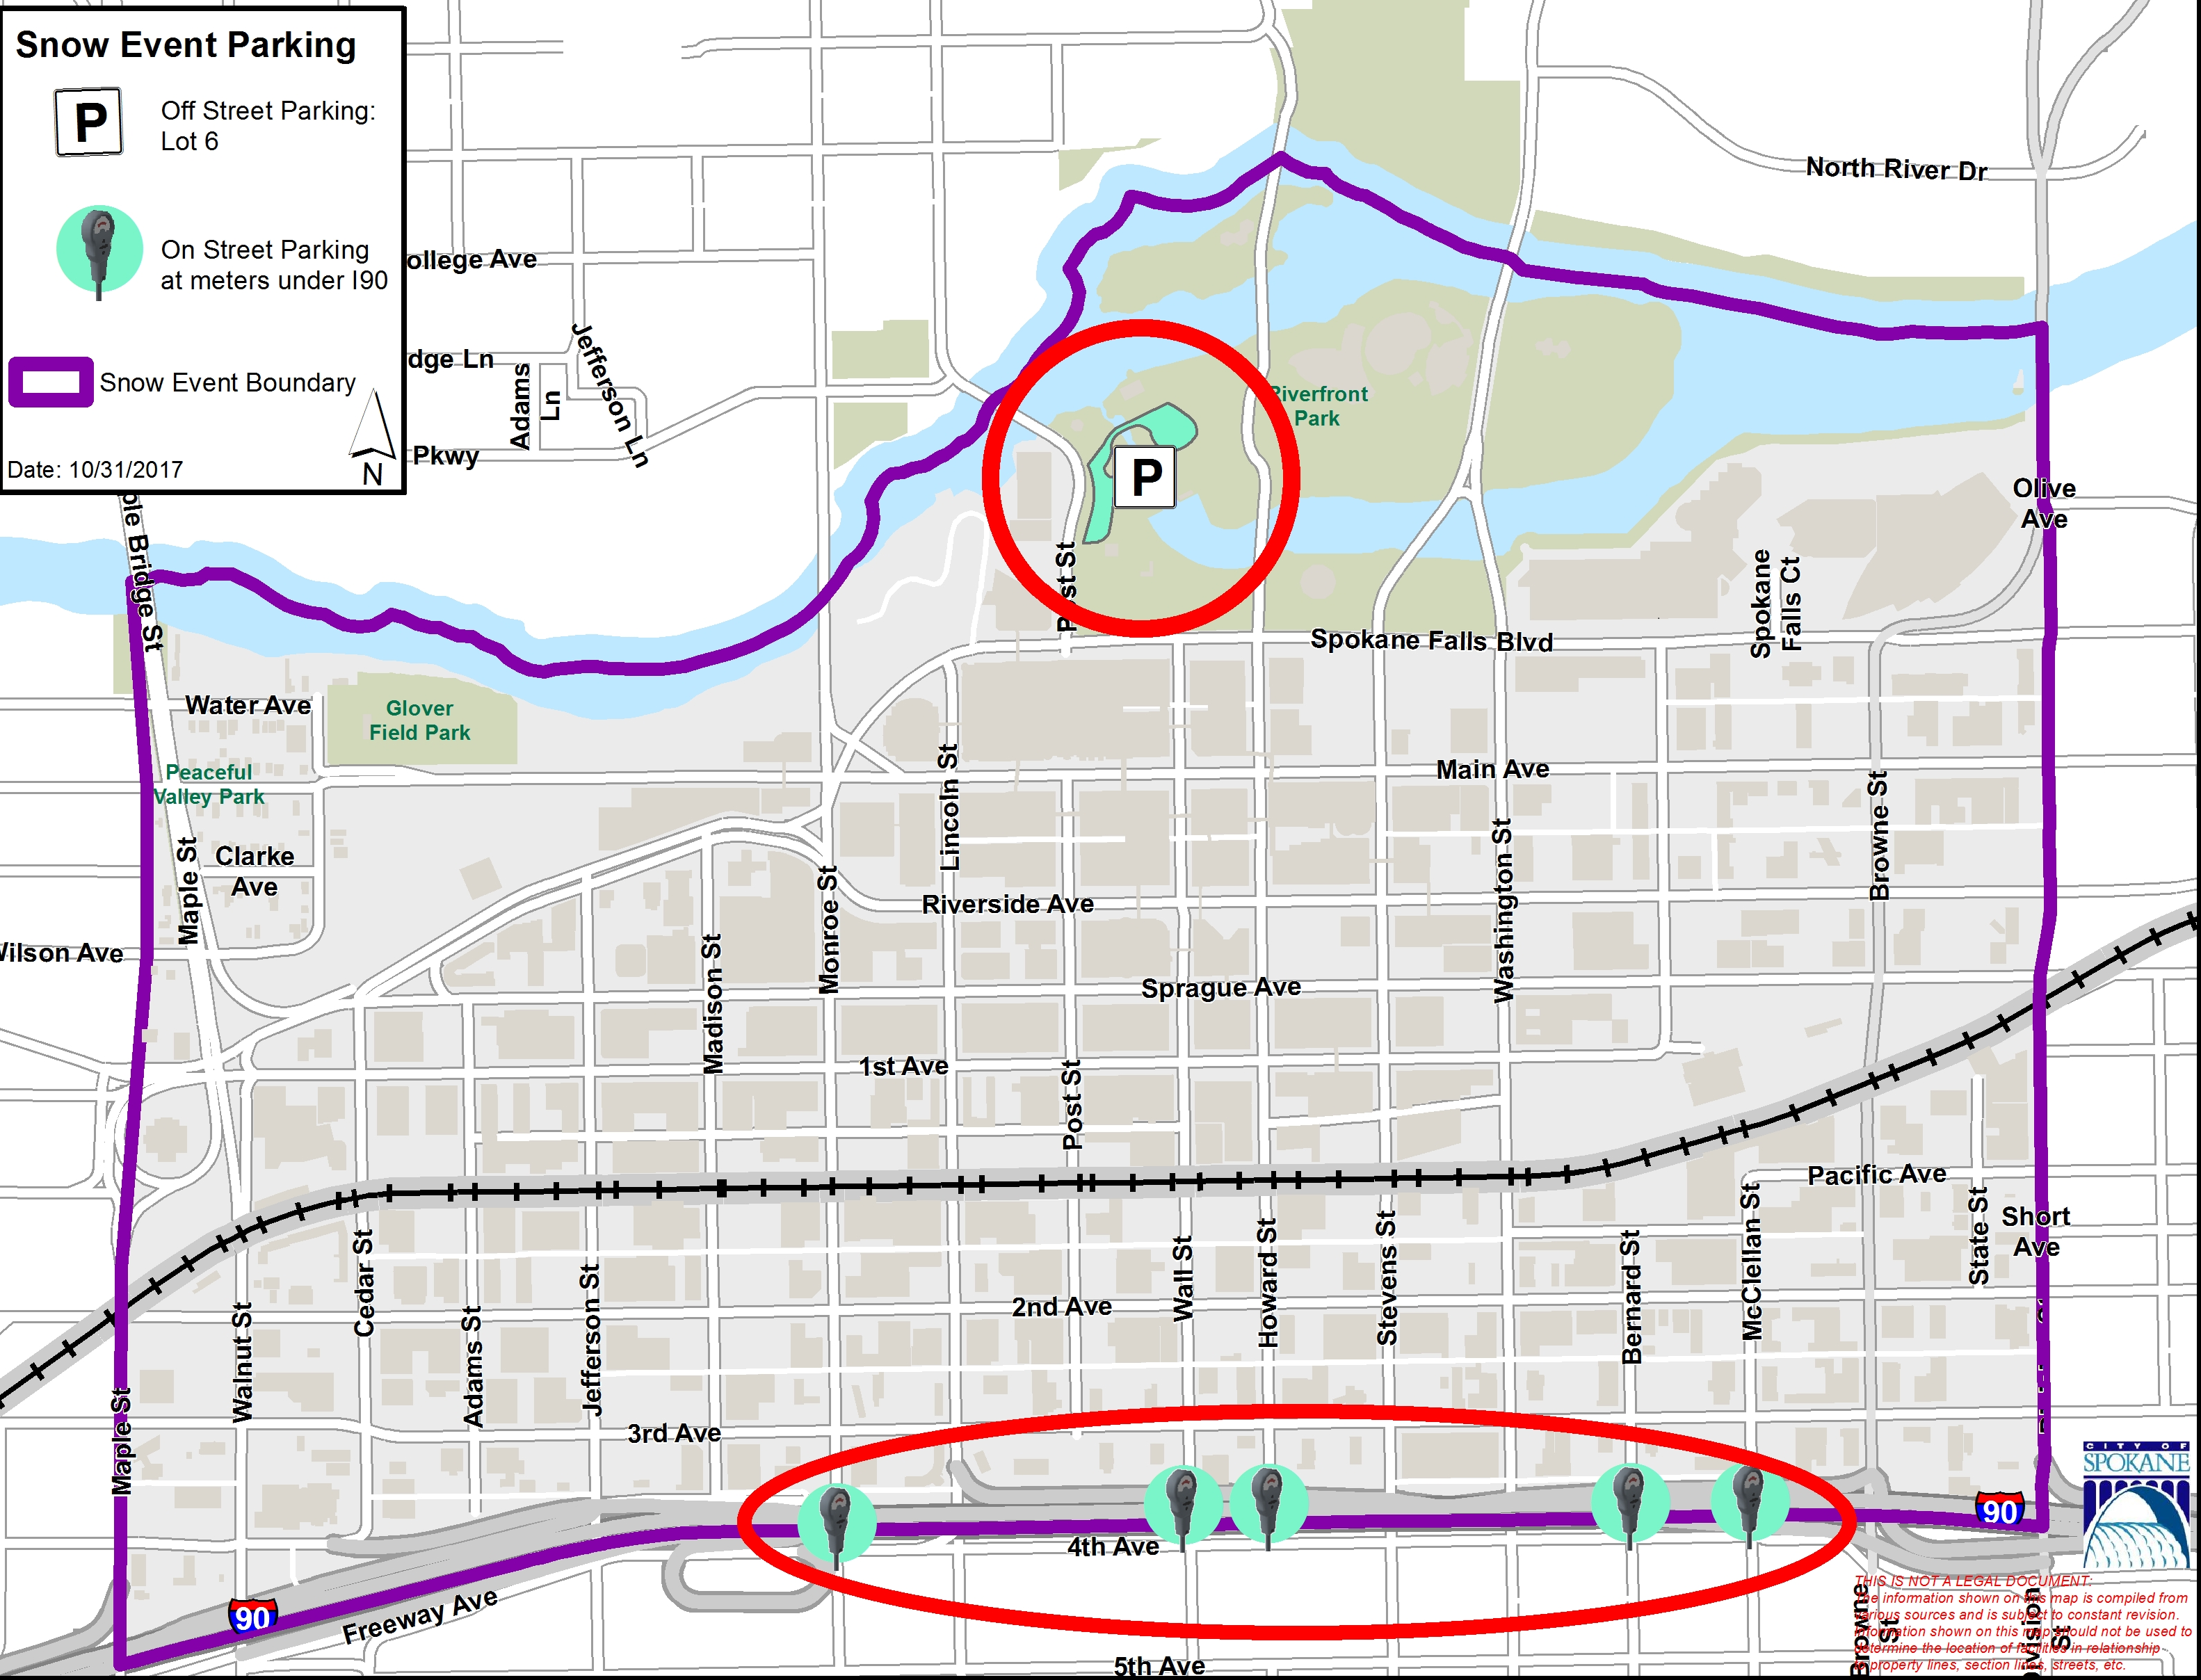
Downtown
Mitigate Impacts
  City offers parking areas within the downtown boundary for where residents can stow their vehicles in a manner that abides signage (most likely North and South of the core)
Downtown boundary
  Maple to Division; Spokane River to I-90

Slide 9
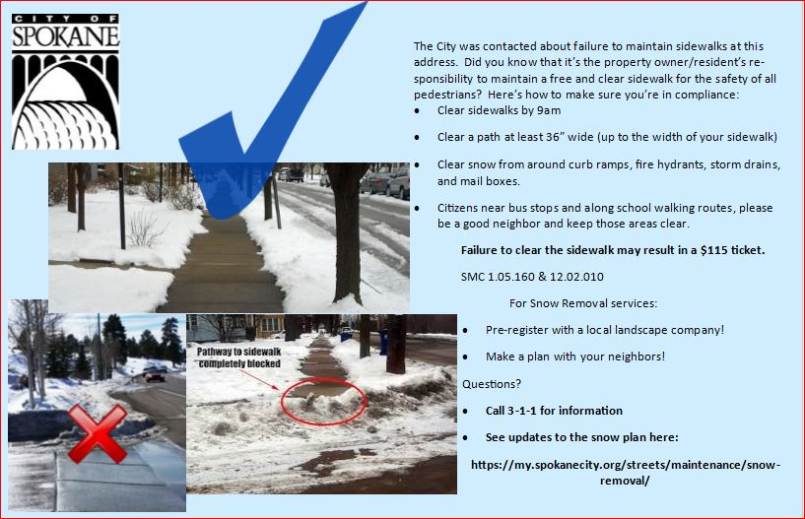
Sidewalks
Education Emphasis
  Survey Results Prioritized Areas: schools, bus stops, hospital districts
  Community Partners: Emphasized students and families walking in the streets due to unclear sidewalks
  Courtesy Notice: Continue to issue notice to property owners & residents when City is notified of unclear sidewalk and pathways
  Mitigation Impacts
  Pre-registration Options for Elderly and Disabled (Aging and Long Term Care of Eastern Washington)
    509.960.7281
  Neighbors helping neighbors to connect with information, resources and a plan!
  Make a plan for the winter

Slide 10
How Can We Collaborate?
Odd side Parking
  Helps the plow minimize berms and get to each neighborhood faster
Removing RVs (trailers, campers, flatbeds, boats, basketball hoops, etc.)
  Remove RVs from the right-of-way during the snow season (Nov. 15-March 15)
  Allows plows to maneuver with greater speed and thoroughness
Connect Resources
  Get to know your neighbors! Pass along Community Minded Enterprise’s information to those that are over 60 and/or over 18 and disabled, pre-registration available
  Did you know that people can pre-register with private landscaping companies?
  Neighbors helping neighbors!
Seasonal Approach, Phased In
  These changes to the plowing, parking and sidewalks are part of changes to make Spokane a more seasonal city
  Thank you for your collaboration, and please feel free to submit a comment card so we can hear from you!

Slide 11
Where to get more info
Watch for Snow Brochure
  Will be inserted in utility bills in November
  Will include residential plow route map (Stick it on your fridge)
Follow the City on Social Media
  @spokanecity on Facebook and Twitter
  We post when we have snow response news to report
Get information on the City’s web site
  A link to snow information will be included on front page
  www.my.spokanecity.org
  Plow Progress map activated during full-City plows
Watch for Information on Local Media
  We are rolling out information to media starting in mid-October
Call 3-1-1 if you need more information

Slide 12
Questions?

